Slide 1
Investigating Technological Supports for Students with Learning Disabilities
Presented by: Teachers on Special Assignment for Learning Disabilities, TVDSB:
Heather Brunet (Secondary school)
Jeannine Hack
Lynne Hart
Karen Rowland
Tim Willick

Slide 2
Goals Of This Presentation:
To show features of Google Suite applications and extensions such as:
Read and Write
EquatIO
Keep

Slide 3
How Can Technology Help a Student with a Learning Disability?
Provides a Personalized Learning Experience for Students:
-offers support with everyday tasks like reading text out loud, understanding unfamiliar words, researching assignments and proofing written work.
Encourages Independent Learning:
-can be used by students of all abilities without supervision, inside or outside the classroom. It works with virtually any kind of educational content – websites, Word files, PDFs, Google docs and more.
-can be a big confidence booster for English Language Learners
-includes valuable extra features that discreetly support students with dyslexia and other learning difficulties.
Notes:
Question: do we need to add an “LD 101” slide as part of the intro?

Slide 4
How Can Google Read and Write Technology Help a Student with a Learning Disability?
Improves reading comprehension: hear web pages and documents read aloud with a choice of natural voices
Helps students understand unfamiliar words with text and picture dictionaries
Develops writing skills and confidence with word prediction
Supports homework and independent research with study skills tools
Turns documents and web pages into MP3 files for easy listening on the move
Assists English Language Learners and students studying a second language
Accessibility features like screen masking give extra support to students with dyslexia and other literacy challenges

Slide 5
This is the tool bar
READ and WRITE

Slide 7
Google Docs
Notes:
Click on Link
Read back function (play, pause, stop) 2. Screenshot reader 3. Word Prediction 4. Screen mask

Slide 8
INTERNET

Slide 9
https://kids.nationalgeographic.com/animals/sloth/#sloth-beach-upside-down.jpg
Notes:
Vocabulary list icon

Slide 10
pdf

Slide 11
Use this link
Click here to Access The Read and Write Handout

Slide 12
Extensions
Google Suite Extensions to help us all!

Slide 13
Grammarly
Grammarly is a free extension that provides spell check, some grammar suggestions and punctuation errors.
A fee is required for additional features.
Notes:
www.grammarly.com
Link to grammarly extension is on grammarly icon.

Slide 15
EquatIO Features:
Easily create math expressions including equations and formulas
Compatible with Google Docs and Forms
Input via keyboard, handwriting recognition (via touchscreen or touchpad) and voice dictation
Guesses what you’re typing or writing – like predictive text on your smartphone
Hear your math expressions read out loud
Notes:
Can be found beside the Read and Write puzzle piece in the top right of your screen, once signed in to your Google account. All students in TVDSB should have the blue diamond, which is Equatio.

Slide 16
Benefits of using EquatIO:
Improves confidence in writing complex mathematical equations.
Helps students with dyslexia, dyscalculia, physical mobility needs, and individuals who experience other academic challenges.
Assists English Language Learners and individuals with English as a Second Language.
Promotes independent learning and supports students in and outside the classroom.

Slide 17
EquatIO Support Video:
https://www.youtube.com/watch?v=BWmPQ7mcKrM&list=PLvSZbmGbKpCRz3o-FmU9AkEpURs9-Z0nH

Slide 18
2:08
EquatIO® for Google: How to Use in Google Docs

Slide 19
Notes:
Google Keep can be found on the waffle (nine dots/ squares) on Google Chrome.
Linked on icon--
https://www.google.com/keep/

Slide 20
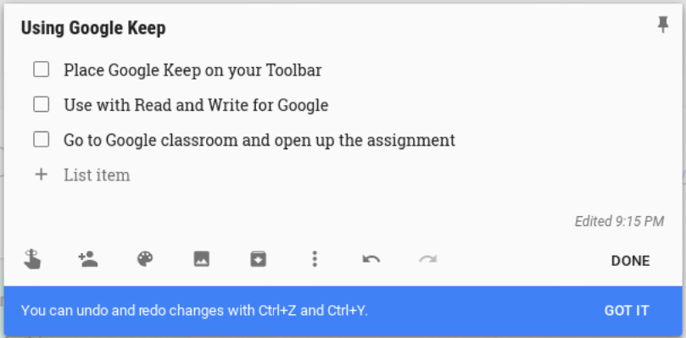
Notes:
Helps students stay organized, track or review progress, highlight important points for study

Slide 21
Add images or use with Read and Write!
Notes:
Google Keep works with Read and Write for Google. You may also add pictures for reminders. Access is on any technology that you use to access your Google account … computer, chromebook, cellphone

