Slide 1
Managing Homework and Study Skills
Ashley Bildfell, PhD Candidate
Mandy Gobatto, M.A., Psychological Associate

Slide 2
Workshop Overview
Homework and Children with Learning Problems
Common Homework Problems
Executive Function Skills
Executive Functions and Study Skills
Managing Stress and Worries about Homework
Resources and Helpful Websites

Slide 3
Homework and Children with Learning Problems
Children with Learning Problems:
Need to do more homework than their peers
Struggle with homework more than their peers
This can lead to frustrations for both the child and family

Slide 4
Common Homework Problems

Slide 5
Common Homework Problems
Difficulty getting started
Takes too long
Too much homework
Low motivation
Kids resist it, complain and end up in tears
Notes:
It is hard to convince my child to start their homework
Homework takes too long
My child has too much homework
My child is not engaged when doing homework
Kids resist it, complain and end up in tears

Slide 6
Common Homework Problems
Confused about what to do
Forgot their books
Does not remember the instructions
Limited notice/limited detail

Slide 7
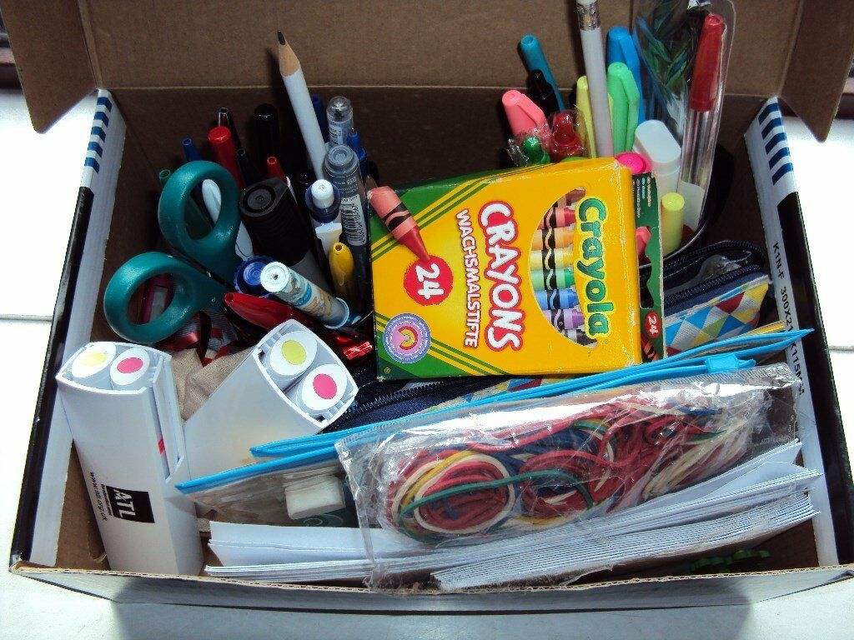
General Homework Tips
Use timers
Consider the timing
Build in breaks
Build in choice
Have all needed materials ready
Notes:
Materials: everything from pencils, sharpener, erasers, ruler, scissors, paper clips, sticky notes, calculator. Try to make some of these fun. Shop at the dollar store for themed, colourful, scented materials. Maybe shop with your child. Decorate the box.
???maybe another slide?? Prioritize; make a daily schedule; incentives if needed; review returned homework and tests for doing things differently next time

Slide 8
General Homework Tips
Prioritize
Add homework to the family calendar
Make a daily schedule
Incentives if needed
Review returned homework and tests
Notes:
Materials: everything from pencils, sharpener, erasers, ruler, scissors, paper clips, sticky notes, calculator. Try to make some of these fun. Shop at the dollar store for themed, colourful, scented materials. Maybe shop with your child. Decorate the box.
???maybe another slide?? Prioritize; make a daily schedule; incentives if needed; review returned homework and tests for doing things differently next time

Slide 9
General Homework Tips
Ask for an extra set of home textbooks
Use a homework system
Check in with your child
Gradually provide less support as they become more independent
Avoid negotiation
Notes:
And finally check up on your child. Take stock of the school situation every single day, to keep on top of homework assignments and stay organized. You could set up a 2-sided pocket portfolio for each class with a different colour for each subject. The left side is for new assignments, the right side is for completed homework that needs to be handed in. Check the left pocket when your child comes home from school to see what must be done that evening and check the right pocket when your child says their homework is finished to make sure that’s actually the case. It’s also good to double check in the morning to make sure your child has ALL of their folders and necessary supplies with them. It is easy it is to walk out of the house having forgotten something even when you’re organized, so double checking in the morning is essential.
Avoid negotiation!!!

Slide 10
How much homework should my child be doing?
10 minutes/grade is the nightly maximum
Notes:
Too much vs too little

Slide 11
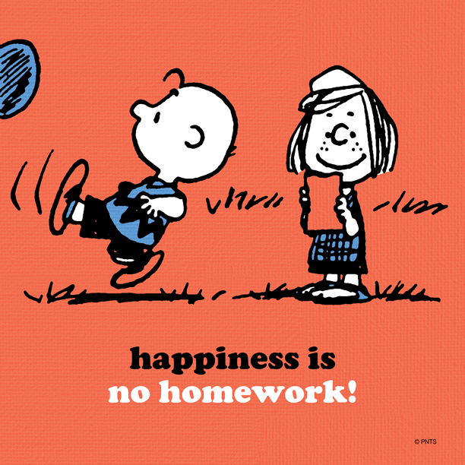
What if my child says there isn’t any homework?
They still need to practice their skills
The following suggestions can help:
Look up a new word
Listen to audio book/read together
Kids national geographic
Notes:
Ixl
Starfall.com
Look up a new word
Listen to audio book/read together
Kids national geographic

Slide 12
Frequent small study sessions
Use active study methods, like flash cards
Use study strategies that practice both recall and recognition activities
Review tests and assignments with your child
Prioritize and make a schedule
Notes:
If your child says they do not need to study, let them see how that works out

Slide 13
Communication with the school
Establish communication with your child’s teacher at the beginning of the school year
Use your child’s agenda as a communication tool
Follow up often
Check teacher websites for homework and assignments
Notes:
Teach child how to communicate with teacher e.g. sticky reminder notes

Slide 14
Skill not Will
Lagging skills most likely explain homework difficulties
Motivation may not be the issue
Therefore incentives may not be effective

Slide 15
Shifting our Thinking
Won’t
Being difficult
Resistant
Doesn’t try
Forgetful/doesn’t care
Can’t
Frustrated/challenged
Doesn’t understand
Tired of failure/fatigued
Working memory breakdown

Slide 16
Executive Function Skills

Slide 17
Executive Function Skills
The skills required to execute a task such as homework

Slide 18
Response Inhibition
Working Memory
Emotional Control
Flexibility
Sustained Attention
Task Initiation
Planning and Prioritization
Organization
Time Management
Goal-Directed Persistence
Metacognition

Slide 19
Executive Skill Profiles
Parent
Child
Notes:
Assess to understand parent and child executive function pattern of strengths and weaknesses. This will help identify problems and guide brainstorming solutions

Slide 20
Executive Skills and Homework

Slide 21
Difficulty Making Homework Plans
Executive Skills Required
Possible Strategies
Task Initiation
Sustained Attention
Planning
Time Management
Metacognition
Write down all assignments
Make sure they have all the materials they need
Determine if they will need help and who will provide it
Estimate how long each task will take
Write down when they will start each assignment
Review and adjust the plan

Slide 22
Difficulty Planning Long-Term Projects
Executive Skills Required
Possible Strategies
Task Initiation
Sustained Attention
Planning
Time Management
Metacognition
Help the child brainstorm topics of interest offering lots of suggestions if needed
Use a Project Planning Sheet
Decide what resources and materials are needed
List all the steps to carry out the project
Develop a timeline
Assist the child in following the timeline

Slide 23
Difficulty Organizing Papers and Notebooks
Executive Skills Required
Possible Strategies
Task Initiation
Organization
Get child input
Help the child decide on a system that will work for each element that needs to be organized
Make a list of the required materials
Set-up notebooks and folders, label everything clearly
Help the child maintain their systems with a daily check-in
Notes:
Provide page 207
No loose papers

Slide 24
Managing Stress and Worries about Homework
Notes:
Handout? Show some?

Slide 25
Homework Stress and Worries
Common causes:
Not knowing what to do
Forgetting materials and instructions
Too much homework
Limited notice
Notes:
Handout? Show some?

Slide 26
Homework Stress and Worries
Start with a mindfulness moment to get in the zone
Begin with the easiest/shortest task
Breathing exercises
Identify if this is a big or a little problem
Use the timer for a 5-minute break
Work for a predetermined amount of time
Notes:
Handout? Show some?

Slide 27
Be kind to yourself
You can only do what you can manage
It is not your responsibility to teach your child
Sometimes it is okay just to let it go
If you only have 15 minutes for homework, you only have 15 minutes for homework
Don’t let homework damage your relationship with your child

Slide 28
Resources and Helpful Websites
Notes:
Handout? Show some?

