Slide 1
Counselling and Accessibility Services
Transition to Post Secondary Studies

Slide 2
Accessibility Services
Some Fanshawe Stats
17,000 full time students
3,685 students and apprentices registered with Accessibility Services last year
Services available at all campuses
London
Simcoe
Woodstock
St. Thomas
Kincardine, Clinton,
Goderich

Slide 3
Secondary | Post Secondary
Ministry of Education policies, rules and guidelines in force Child centered – others may have responsibilities for you Student is considered “exceptional”; has rights to educational services Focus is on meeting your educational need (extended deadlines, credit recovery etc.) School has all the necessary paperwork for your IEP May have locally developed courses to suit student need Full time teachers, with expertise in learning | MAESD and Human Rights Code in force; these are significantly different that those of Ministry of Education Adult centered – you are responsible for yourself Student has “documented disability”; accommodations to reduce barriers Focus is on accommodations based on documentation You must provide documentation to the college Must meet published learning outcomes Many part-time teachers, with expertise in subject

Slide 4
What’s considered a disability?
Acquired brain injury
Autism spectrum disorder
Attention deficit disorder
Chronic illness, medical
Deaf, deafened, hard of hearing
Learning disability
Low vision, blind
Mental health (anxiety, depression,
bi-polar disorder, schizophrenia, etc.)
Mobility, functional
Other (communication, intellectual disability)

Slide 6
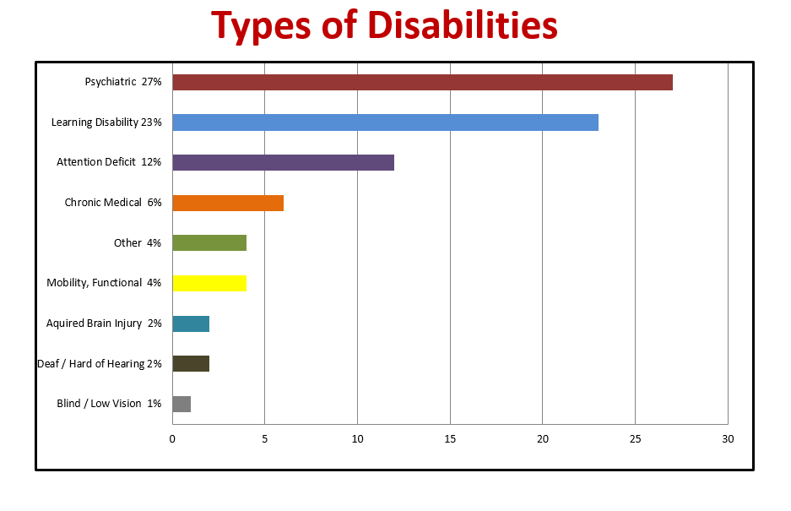

Slide 7
Documentation – the crucial piece
We accept:
For a physical, medical or
mental health condition (including ADHD):
Medical form (available on our website) or letter from medical practitioner
For a learning disability or ADHD:
Psycho-educational assessment or recent IPRC, IEP statement
Temporary and interim
accommodations available

Slide 8
Possible Accommodations
Accommodations are based on documentation, individual needs and program requirements
Note taking assistance
Accommodations for tests and exams
Extra time, quiet space, computer, adaptive technology etc.
Peer tutoring – help with subject matter
Peer assistance – help with tasks
Individual classroom accommodations
Preferential seating; late for class; food or drink; breaks; etc.

Slide 9
Possible Accommodations
Reduced course load in most programs and possible tuition cap
Books in alternate formats
electronic formats, large print
Special furniture
Adjustable chairs or desks
Wellness room (at main campus)
Pain management, sensory issues
ASL interpreting
Specialized services for those who qualify

Slide 10
Additional Supports
Counselling
disability, self-advocacy, pre-admission, personal, academic and career
Psycho-educational assessments
in house, or referred to community providers
Individual or group learning strategies
Workshops and support groups
New Wellness Centre
Accessibility Lab
Adaptive technology, workshops,
training
Personal Emergency Plan

Slide 11
Sounds great, but…
How are these services covered?
Do I have to pay?

Slide 12
Funding Possibilities
Most services covered by government funding - no charge for accommodations
Additional funding possibilities
Grant
Bursary for Students with Disabilities (BSWD)
Can use BSWD for equipment and some professional services
Equipment received through the BSWD belongs to the student
BUT - Must qualify for OSAP to be eligible
Must indicate a permanent disability on OSAP application

Slide 13
BSWD
BUT…
Documentation for BSWD is stricter than documentation for accommodations and other services
We work with students to obtain acceptable documentation
May require a re-assessment of learning disability
We can help arrange the re-assessment

Slide 14
Other Routes to a Career
Apprenticeships:
Government program to support apprentices with disabilities
Specialized services
Equipment loans
Learning coaches
CICE
Community Integration through Cooperative Education
For those requiring modifications

Slide 15
But what if I’m not sure what I want?
Fanshawe Website
www.fanshawec.ca
Fanshawe Pathfinder
www.fanshawepathfinder.ca
Fanshawe Advising Centre
www.fanshawec.ca/advising

Slide 16
How do I start?
Start planning early – before you apply
Ask our Advising Centre for program information
Contact the coordinator of the program for detailed information
Attend Open House
Pre-admission counselling through Accessibility Services if you need specific information related to your disability

Slide 17
Pulling it All Together…
Apply to college and accept offer of admission
Assemble and submit your documentation
Contact Accessibility Services at www.fanshawec.ca/earlyid starting in June (for Sept. starts) – don’t wait until the fall!
Attend an orientation session (main campus)
Meet with your counsellor

Slide 18
Putting it All Together…
Review documentation and learning needs with counsellor
Accommodation form is created
Counsellor provides professors with accommodation form
Stay connected! Counsellors and staff are here to help!

Slide 19
What Do Other Students Find Helpful?
Using a calendar or planner
Studying in a quiet and distraction-free location
Using earplugs for concentration
Highlighting and underlining important text
Constantly reviewing the material
Sitting at the front of the class
Asking for help from classmates and friends
Studying using practice tests; setting a timer for studying
Setting short- and long-term goals
Creating daily routines and organizing their time
Using technology such as e-books and adaptive software
From:
Perspectives of North American Postsecondary Students with Learning Disabilities: A Scoping Review (Lightfoot et al, 2018)

Slide 20
Thanks!
Questions? Comments?
Contact us – we want to help!
Fanshawe College
Counselling and
Accessibility Services
Room F2010
519-452-4282

