Slide 1
The 5 Big Ideas in Beginning Reading

Slide 2
The 5 Big Ideas in Beginning Reading
Where did the 5 Big Ideas in Beginning Reading come from?
In 2000, the National Reading Panel was formed to review research on how children learn to read and determine which methods of teaching reading are most effective based on the research evidence.
www.reading.uoregon.edu

Slide 3
The 5 Big Ideas in Beginning Reading
PA
PA is foundation for the development
of all the other Big Ideas
Notes:
Q: What is the purpose of reading? A: To gain meaning from text (i.e. comprehension)

Slide 4
BIG IDEA #1 = Phonological Awareness Phonological Awareness is NOT Phonics
Phonological Awareness
Phonics = Alphabetic Principle
NOT PRINT
ORAL language skills that involve understanding the different ways in which spoken language can be broken down and manipulated
Examples = rhyming, clapping out syllables, identifying beginning/ending sounds, counting words in sentences, blending sounds to make words
PRINT
A method for teaching reading that makes the relationship between letters and their sounds explicit
“The K says /k/”

Slide 5
Phoneme Segmenting
SEGMENTING WITH BEADS
(Make,Take&Teach)
Notes:
Things to note in video:
No mention of letter names (only sounds).
No print

Slide 6
BIG IDEA #1: Phonological Awareness
PHONOLOGICAL AWARENESSS
PHONEMIC AWARENESS
Broad term- includes phonemic awareness
Identify and manipulate larger parts of spoken language (rhyme, syllable, words)
Narrower, subcategory of phonological awareness
Identify and manipulate individual sounds of spoken words

Slide 7
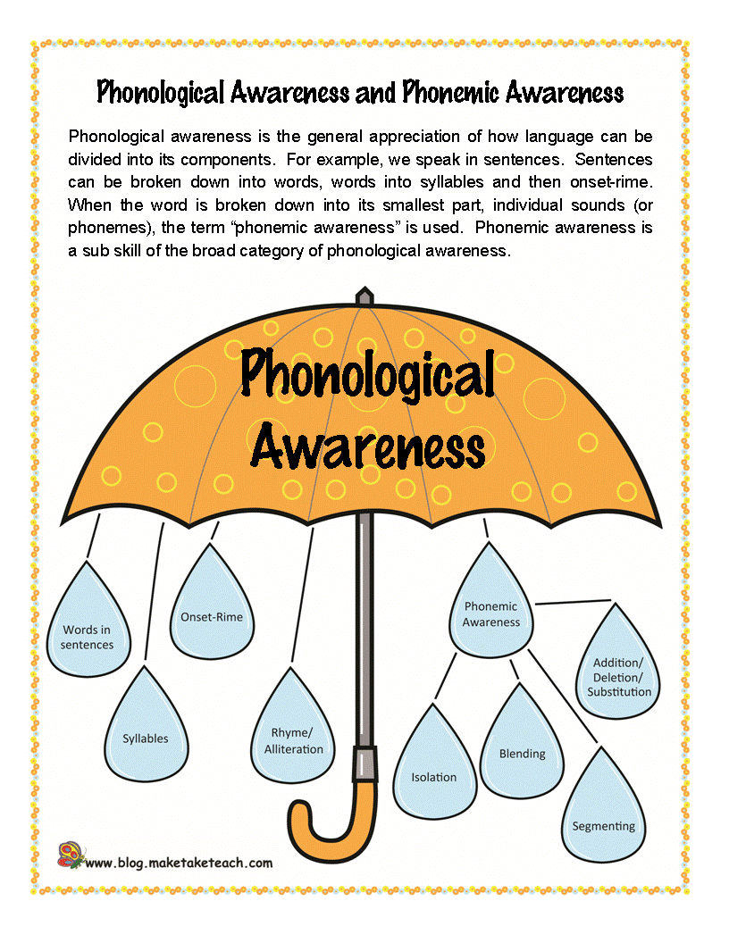
BIG IDEA #1: Phonological Awareness
http://reading.uoregon.edu/big_ideas/pa/pa_skills_seg.php#
https://m.youtube.com/watch?v=dquCtrqbKpY

Slide 8
BIG IDEA #1: Phonological Awareness
Phonological Awareness Hierarchy
Skill | Example | Period of Acquisition
Rhyming
Recognition | Does dog rhyme with log? | Kindergarten
Completion | Along came a sheep riding in a … | Kindergarten
Production | What rhymes with blue? (shoe) | Kindergarten
Syllable
Segmentation | Pen-cil, hel-i-cop-ter | Kindergarten
Deletion | Cupcake without the cup (cake) | Kindergarten

Slide 9
BIG IDEA #1: Phonological Awareness
Phonological Awareness Hierarchy (cont’d)
Skill | Example | Period of Acquisition
Phoneme
Discrimination | Do these sound the same? /d/-/t/ | Kindergarten
Isolation/identification of initial sounds | What’s the first sound in shoe? /sh/ | Kindergarten
Isolation/identification of final sounds | What’s the last sound in dog? /g/
Isolation of medial sounds | What’s the middle sound in big? /i/ | Grade One
Blending | What am I saying? /p/-/ou/-/ch/ (pouch) | Grade One
Segmentation | What are the sounds in bat? (/b/-/a/-/t/) | Grade One
Deletion | Say meat without /m/. (eat) | Grade One
 | Say meat without /t/. (me) | Grade One
 | Say clap without /k/. (lap) | Grade Two
 | Say clap without /l/. (cap) | Grade Three

Slide 10
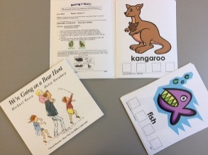
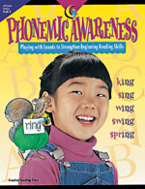
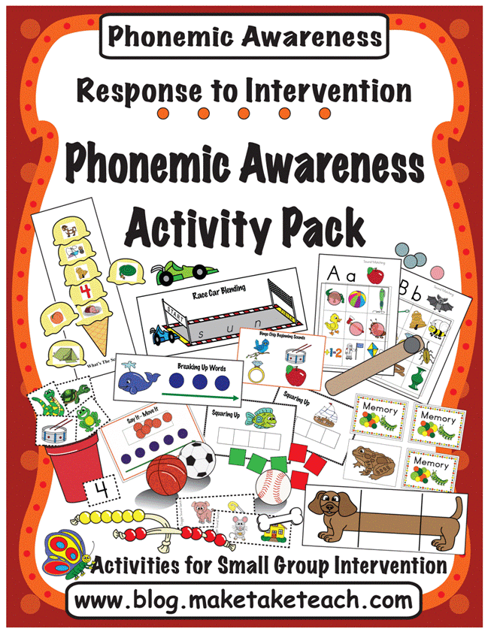
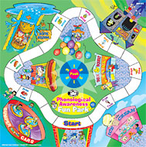
BIG IDEA #1: Phonological Awareness Resources
Kindergarten Language and Literacy in the Classroom (KLLIC)
Sounds Abound Storybook Activities (Linguisystems)
Phonemic Awareness: Playing with Sounds to Strengthen Beginning Reading skills (www.creativeteaching.com)
Make, Take & Teach: Phonemic Awareness Activity Pack
(www.maketaketeach.com)
Phonological Awareness Fun Park
(www.superduperinc.com)

Slide 11
BIG IDEA #1: Phonological Awareness Activities
Syllable deletion
KLLIC (cycle 2)
Phoneme isolation
Stop that sound (KLLIC – cycle 7 intro)
Head, Waist, Toes (page 51 top – Phonemic Awareness)
Doggie Where’s My Bone (Make, Take & Teach)- video example

Slide 12
Phoneme Isolation
Doggie, Where’s
My Bone?
(Make, Take & Teach)

Slide 13
BIG IDEA #1: Phonological Awareness Activities
Phoneme Blending
Bubble Gum words (page 31 top – Phonemic Awareness)
Segmenting
Squaring Up (Make, Take & Teach)- video example

Slide 14
Phoneme Segmenting
SQUARING UP
(Make,Take&Teach)

Slide 15
BIG IDEA #1: Phonological Awareness
Phonological awareness is ORALLY processing the sounds and sound patterns in language.
It is an essential precursor to phonic knowledge (PRINT).
Sound/letter relationships are meaningless if you are unable to process those sounds in language (i.e., Jolly Phonics without phonological awareness skills).

Slide 16
BIG IDEA #2: PHONICS
PHONICS = ALPHABETIC PRINCIPLE
Letter Factory = Letter-Sound Correspondence (video)

Slide 17
BIG IDEA #2: Phonics
Alphabetic principle requires 2 essential skills:
Sound-Letter Correspondence: The ‘S’ says /ssssss/
Word Reading: sound out/decode words
(e.g. /ssss-aaa-t/= sat)
PA skill (ORAL blending) required to blend sounds in PRINT
Notes:
Example of decoding without PA foundation: ‘sip’= sss-iii-p → pin

Slide 18
Decoding Hierarchy
Least Difficult
VC Words - at, up
CVC Words -sat, cup
CCVC Words (blends) – stop, flip
Consonant Digraphs- thin, wash, chip
CVCe Words (silent e)- kite, make
Vowel Digraphs (2 vowels go walking) – bait, toe, meat
Diphthongs – boy, mouse, coin
R-Controlled Vowels- forest, teacher, purse
Most Difficult

Slide 19
BIG IDEA #2: Phonics Successive Blending Strategy
8 step sequence for blending
Place the letter cards “s” “a” and “t” separated in a pocket chart or blending board
1. Point to the “s” and say /s/
2. Point to the “a” and say /a/
3. Physically slide the “a” over to the “s”
4. Slide finger along the “sa” and say /sa/
6. Point to the “t” and say /t/
6. Move the “t” card next to the “sa” to make the word “sat”
7. Slide finger under “sat” and say “sat” slowly
8. Read the word naturally
s

Slide 20
SIGHT WORDS- The words we cannot decode
High Frequency Words are those words that appear most often in written texts (constitute more than 50% of the words that early readers encounter)
High Frequency Words are often difficult for children to master because many of them cannot be sounded out/decoded
Examples: “the”, “said”, “for”, and “where”.
Sight words are abstract, they do not trigger a concrete image (e.g. “were” vs. “cat”)
GOAL: See it→ Say it (DO NOT sound it out)

Slide 21
HIGH FREQUENCY WORDS- Resources
eyewords
Dolch Words www.dolchsightwords.org
Nelson Kindergarten Teacher’s Book
(page 94- List of High-Frequency Sight Words)
Reading A-Z www.readinga-z.com

Slide 22
BIG IDEA #2: Phonics
Research Evidence
Most children do NOT learn to read or spell “naturally”, rather they learn from instruction.
Decoding is an essential and primary means of recognizing words. There are simply too many in English to rely on memorization.
Good word identification does NOT primarily rely on guessing words from context or picture cues.
Spelling words as they sound (invented spelling) enhances PA and letter knowledge and accelerates the acquisition of conventional spelling.
Simmons, University of Oregon, 2002

Slide 23
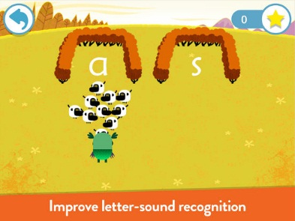
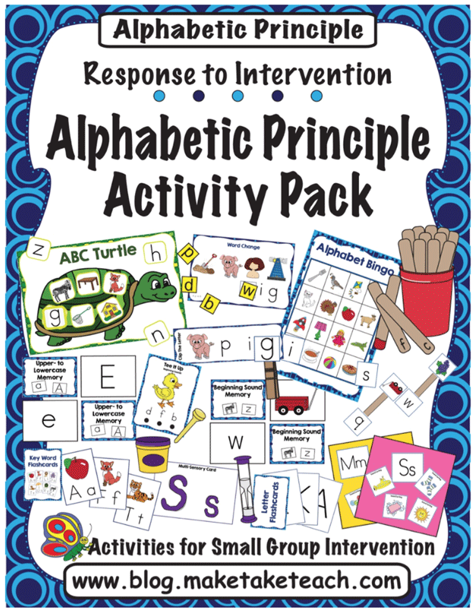
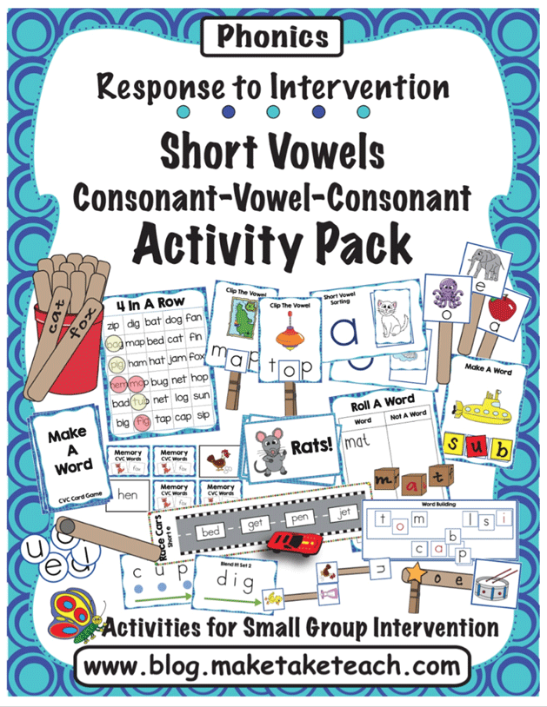
Alphabetic Principle/ Phonics/Decoding Resources
www.teachyourmonstertoread.com
Jolly Phonics
Make, Take & Teach: Alphabetic Principle Activity Pack
www.maketaketeach.com
Make, Take & Teach: Short Vowels & CVC Activity Pack
www.maketaketeach.com

Slide 24
BIG IDEA # 1 & 2
Phonics builds on the foundation of phonemic awareness
The ability to apply phonic knowledge depends on satisfactory phonological awareness, but both can be developed together.
It is important to incorporate phonological awareness activities (ORAL) AND activities which teach how to ‘map’ those sounds onto letters or letter patterns (PRINT).
Notes:
i.e. activities that combine PA with phonics. Helps students to apply PA skills to print.

Slide 25
Oral Segmenting + Alphabetic Principle
Say it, Move it
Say it, Move it with letters
(Make, Take & Teach)

Slide 26
BIG IDEAS #1 & 2
“The combination of instruction in phonological awareness and phonics is the most favourable for successful early reading.”
(Haskell, Foorman, & Swank, 1992)

Slide 27
BIG IDEA #3: Vocabulary
At ages 4 and 5, about 20% of all children show delays in vocabulary development (Ontario Ministry of Child and Youth Services)
Successful readers in Grade 1 or 2 are often unable to understand books they need to read by Grade 3 or 4 due to lack of adequate vocabulary (Canadian Language & Literacy Research Network)
By Grade 4, children whose vocabulary knowledge is below grade level are likely to have difficulties in reading comprehension, even if their word identification skills are strong (Supporting Students’ Vocabulary Development Through Play, Peterson, February 2016)
Notes:
Bullet 3: i.e. the student can decode words but not understand individual word meanings therefore can’t comprehend the text

Slide 28
Notes:
Now if we tell you that a “rhizome” is a underground plant stem capable of producing the shoot and root systems of a new plant. Does that help your comprehension of the passage??

Slide 29
BIG IDEA #3: Vocabulary
The relationship between reading comprehension and vocabulary knowledge is strong and unequivocal
(Baumann & Kame’ennui, 1991; Stanovich 1986)
Even weak readers’ vocabulary knowledge is strongly correlated with the amount of reading they do
(Cunningham & Stanovich, 1998)

Slide 30
BIG IDEA #3: Teaching Vocabulary
Vocabulary instruction should include:
Intensive study of some words involving multiple exposures in a range of meaningful contexts
Direct teaching and modeling
Opportunities to use new vocabulary in discussions about books and related activities
Guided reading is an optimal time to target vocabulary

Slide 31
BIG IDEA #4 Fluency
Fluency = speed + accuracy
40% of Grade 4 students read primarily in 1- or 2- word phrases, with little or no recognition of sentence structure
Fluency is the bridge between decoding/word recognition and comprehension.
Students who score lower on fluency also score lower on comprehension.
The Importance of Reading Fluency (video)

Slide 32
Notes:
Difficulty decoding/ word recognition made it very difficult to fully comprehend the passage.
Q- What is the main idea of this passage? A- Fern looks after Willbur
Q- What does Fern specifically do to look after Wilbur? A- Feeds him
Slow, effortful reading results in partial comprehension rather than full comprehension of the passage

Slide 33
BIG IDEA #4 Fluency
“If a reader has to spend too much time and energy figuring out what the words are, he/she will be unable to concentrate on what the words mean”.
(Coyne, Kame’ennui, & Simmons, 2001)

Slide 34
BIG IDEA #5 Comprehension
Decoding
Oral
Language
Comprehension
The goal of reading is to obtain meaning from written text
Integrating oral language knowledge and decoding ability is required to achieve reading comprehension
Reading Comprehension in Kindergarten (video)
Notes:
If student has weak oral language skills but can decode…that is like the rhizome example.
If adequate oral language, but weak decoding…..that is like Charlotte’s Web example.

Slide 35
Reading fluency is necessary but not sufficient for reading comprehension
ORAL LANGUAGE
DECODING
You must be able to read (decode) the words in order to comprehend the text
You must be able to understand the words (vocabulary) to comprehend the text

Slide 36
The 5 Big Ideas in Beginning Reading
PA
To comprehend text, adequate
vocabulary is required
To develop vocabulary, we need access to texts at the right level. To read those texts, and absorb
meaning, we need to have developed reading fluency
PA
Fluency requires satisfactory sight word vocabulary (words we no longer have to decode) and automaticity with PA and phonics.
PAFlu
Decoding can only develop if we have an
awareness of the sound (phonemes) of language.
PA
PA
PA is foundation for the development
of all the other Big Ideas

Slide 37
Tier 1 (Whole Class) Reading Resources
Kindergarten
Phonological Awareness (see resources)
Make, Take & Teach (Alphabetic Principle)
Reading A-Z Decodable Books
Jolly Phonics
Teach Your Monster to Read
Grade 1
Phonological Awareness (see resources)
Make, Take & Teach
Reading A-Z Decodable Books
Teach Your Child to Read in 100 Easy Lessons
Reading Mastery

Slide 38
Tier 2/3 Reading Intervention
Start with the foundational skills (Phonological Awareness & Alphabetic Principle- Big Ideas 1&2)
Reading Mastery/ Teach Your Child to Read in 100 Easy Lessons/ Corrective Reading
Student has adequate oral language (receptive/expressive language) and cognitive skills
Difficulty processing at the phoneme level (ORAL)
Difficulty blending sounds while decoding (PRINT)
Reading Milestones
Effective for students with language delays, developmental disabilities, communication impairments, hearing impairments, and English Language Learners (ELL).

Slide 39
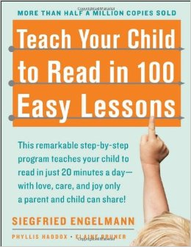
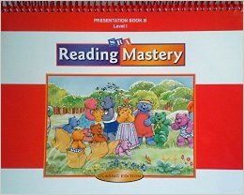
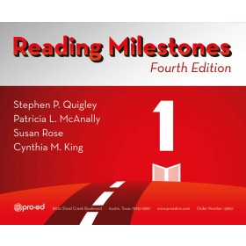
Reading Resources
Teach Your Child to Read in 100 Easy Lessons
Reading A-Z Decodable Books & Phonics Lessons
Reading Mastery/
Corrective Reading
Reading Milestones
Notes:
Leveled Readers: for students who already have foundational skills (PA and phonics). They are working on improving fluency and possibly increasing automaticity with PA and phonics.
Decodable Books: for students who need help with decoding.
Both books look the same.

Slide 40
Contact Information
Cheryl Cameron
Speech-Language Pathologist
London District Catholic School Board
(519) 663-2088 x 39000
ccameron@ldcsb.ca
Janice Long
Speech-Language Pathologist
London District Catholic School Board
(519) 663-2088 x 39004
jlong@ldcsb.ca

