Slide 1
Individual Education Plans
Marci Damen – TVDSB Coordinator Special Education
Lynn-Marie Pearce – LDCSB Consultant Special Education

Slide 2
Goals for Today
Policy and Program Memorandum 8
Operationalizing Strengths
Linking IEP Strengths/Needs to Accommodations
Connecting IEP Program Areas to skill building
Utilizing the Transition Plan
Notes:
We hope that we will help you to view the IEP as a useful document that reflects the individual strengths and needs of the student. It is more than a piece of paper....

Slide 3
Notes:
PPM 8 outlines our responsibilities as school boards, in identifying and programming for students with Learning Disabilities

Slide 4
Operationalizing Strengths
Strengths
learning styles and preferences (e.g., visual, auditory, kinesthetic learner)
Previously acquired learning skills (e.g., organizational skills, time management skills)
Cognitive processing and communication abilities (e.g., expressive language – speaking)
Needs
broad cognitive and/or processing challenges (e.g., in the area of visual memory)
skill deficits that relate to the student’s exceptionality and/or interfere with the student’s ability to learn (e.g., in areas such as social skills, attention, emotional control, expressive language – writing)
Special education in Ontario Kindergarten to Grade12 p. E16

Slide 5
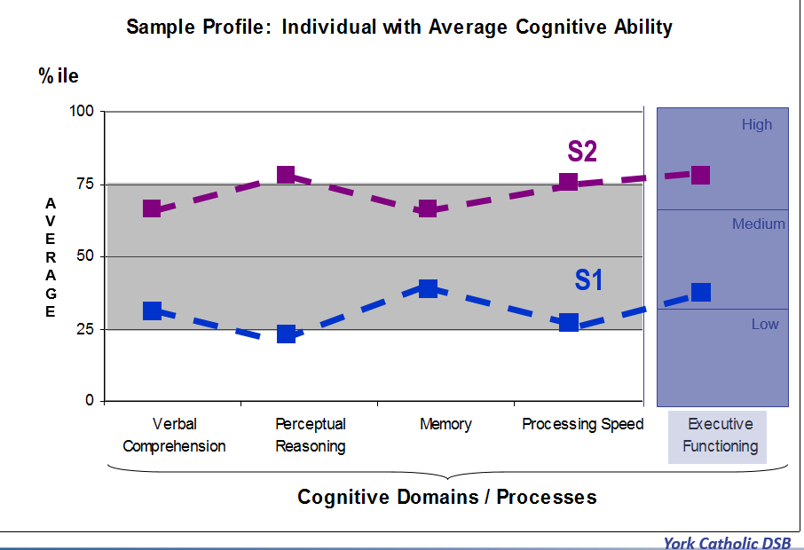
High
S2
AVERAGE
Medium
S1
Low
York Catholic DSB
Notes:
This graph is showing the profile of two students who are not identified and who have average cognitive abilities and executive functioning
On this graph, the vertical axis shows the percentile rankings. On the horizontal axis, the four cognitive processes plus executive functioning are listed.
Verbal Comprehension is the ability to listen to and understand language
Perceptual Reasoning includes nonverbal fluid reasoning, spatial processing and visual perception. Activities such as organizing and classifying objects, drawing inferences and problem solving use perceptual reasoning skills
5

Slide 6
LD 2
High
AVERAGE
Medium
Low
LD 1
York Catholic DSB
Notes:
What might you need to think about to support these two different students in math?
Notice that there is a significant discrepancy between strengths and needs; needs are often in the below average range, yet strengths are in the average to above average range) and the differences in the strengths and needs between these two students means that presenting material and completing assessment the same for each person most likely would not give you an accurate measure of their performance.
Consider how executive functioning would effect each student in this example. How could it influence Teacher perception of skills?
<Show student with LD 2 (LD2).> Ask participants to turn and talk about what is similar / different about this profile compared to LD2 (e.g. 3 of 4 cognitive processes are opposite strength/needs; once again, a significant discrepancy between strengths and needs; again, needs are often in the below average range, yet strengths are in the average to above average
6

Slide 7
Strengths
Strengths
Visual learner
Memory
Verbal comprehension
Oral expression
Works well in groups
Visual Learner
Learns well when material is presented in picture or concrete forms
Benefits from using graphic organizers to brainstorm
Visuals support comprehension of spoken and written material
Remembers visual information better e.g., diagrams, charts, graphs, material they have written/typed
May like flashcards for studying
May need to cover parts of the page to help focus on one part at a time

Slide 8
Strengths
Strengths
Visual learner
Memory
Verbal comprehension
Oral expression
Works well in groups
Oral expression
May have an expanded vocabulary
May be successful when expressing thoughts and feelings, describing or explaining experiences of concepts
May need to talk through concepts, ask questions to clarify understanding
May benefit from opportunities for group discussion
May like to study using Mnemonics, or by reading information out loud
May be able to provide verbal answers with increased details and complexity vs written answers

Slide 9
WHAT DOES PPM 8 SAY ABOUT IEPS FOR STUDENTS WITH LEARNING DISABILITIES?
Instructional, environmental, and assessment accommodations should be provided, as appropriate, so that the student is able to access grade-level curriculum expectations and to demonstrate learning.

Slide 10
Accommodating Strengths & Needs
Instructional accommodations:
Adjustments in teaching strategies required to enable the student to learn and to progress through the curriculum
Environmental accommodations:
Changes or supports in the physical environment of the classroom and/or the school
Assessment accommodations:
Adjustments in assessment activities and methods required to enable the student to demonstrate learning

Slide 11
Accommodating Strengths
Strengths
Visual learner
Memory
Verbal comprehension
Oral expression
Works well in groups
Instructional Accommodations
Present information visually, pair verbal and visual information and instructions
Assistive technology such as text to speech software that highlights as words or sentences are read
Video recordings of lessons for intensive review at a later time
Descriptive feedback from peers, small group discussions e.g., Kagan Structures
Assessment Accommodations
Assistive technology such as speech to text, and text to speech software
Allow for oral explanations of written answers
Alternate settings
May do well with multiple choice questions

Slide 12
Accommodating Needs
Needs
Reading – Decoding
Written expression
Executive Functioning – focus, organization, task completion
Math computation
Processing speed
Instructional Accommodations
Use of assistive technology (text to speech and speech to text)
Duplicate or electronic notes
Graphic organizers and mind maps
Organizational coaching and time management aids
Visual and verbal cueing
Extra time for processing
Use of manipulatives
Environmental Accommodations
Strategic seating near the teachers desk, beside a calm peer
Quiet setting
Use of headphones or study carol when needed

Slide 13
Accommodating Needs
Needs
Reading – Decoding
Written expression
Executive Functioning – focus, organization, task completion
Math computation
Processing speed
Assessment Accommodations
Oral responses, including recorded responses (audio or video)
Oral explanations of written answers
Use of assistive technology (text to speech and speech to text)
Access to learning tools (manipulatives, number chart)
Prompts to return student’s attention to task
Extended time limits
Reduction in the number of tasks used to assess a concept or skill

Slide 15
WHAT DOES PPM 8 SAY ABOUT Program Modifications on IEPS FOR STUDENTS WITH LEARNING DISABILITIES?
Modification of learning expectations may include the use of expectations at a different grade level and/or an increase or decrease in the number and/or complexity of expectations. Modified learning expectations that are drawn from a lower grade level will only be considered if the student cannot demonstrate learning with the aid of any of the approaches and/or strategies described above.

Slide 16
Modified Program Area
Learning Expectations
Writing (grade 4)
Sally will write a complete final draft of a paragraph that includes a topic sentence, three supporting sentences and a concluding sentence including the correct use of spelling, capitalization and punctuation.
Teaching Strategies
Use of a model paragraph co-constructed with a peer with feedback from the teacher
Use visual /pictorial organizer when brainstorming ideas
Choose a topic of high interest
Assessment Methods
Written paragraph
Paragraph rubric

Slide 17
Modified Program Area
Learning Expectations
Reading (grade 2)
Sally will read the 41 words on the Grade 1 Dolch sight words list and the 46 words on the Grade 2 Dolch sight word list
Teaching Strategies
Daily practice with flashcards
Identify sight words in written material (paper or electronic texts)
Pair pictures with words whenever possible
Use sight words in games e.g., go fish, memory, in word searches
Assessment Methods
Sight word checklist
Oral interview
Observation

Slide 18
WHAT DOES The Ministry of Education SAY About Alternative Programs or Courses?
Alternative Program Areas
“Alternative expectations are developed to help students acquire knowledge and skills that are not represented in the Ontario curriculum… Because they are not part of a subject or course outlined in the provincial curriculum documents, alternative expectations are considered to constitute alternative programs or alternative courses. ...For the vast majority of students, these programs would be given in addition to modified or regular grade-level expectations from the Ontario curriculum.” Special education in Ontario Kindergarten to Grade12 p. E18

Slide 19
Alternative Program Areas
Alternative programming (ALT) focuses on knowledge and skills related to identified needs that may impact a student’s access to other curriculum areas. Targeting skills in alternative areas increases the opportunities for success in other curriculum areas while reducing barriers.
Alternative programming (ALT) for student with Learning Disabilities is often related to developing the Learning Skills and Work Habits that are listed on the Ontario Report Card in Elementary School and the Progress report in Secondary School.

Slide 20
Alternative (ALT) Program Area
Annual Goal: Sally will indicate her readiness for class by having her materials ready to use. She will seek clarification when she does not understand an instruction or assignment. Sally will use technology to support her time management and organizational skills.
Learning Expectations
Organization
Sally will bring all of her books and material needed (text books, pen laptop, and notebook) with her to each of her rotary classes a minimum of 4/5 days per week
Teaching Strategies
Peer helper to cue looking at her checklist on her pencil case
Use of a soft cloth bag for all of her materials to be kept at her desk
Assessment Methods
Observation checklist
Self recording daily

Slide 21
Alternative (ALT) Program Area
Annual Goal: Sally will indicate her readiness for class by having her materials ready to use. She will seek clarification when she does not understand an instruction or assignment. Sally will use technology to support her time management and organizational skills.
Learning Expectations
Work Completion
Sally will restate an instruction given or describe an assignment to her elbow partner or to the teacher a minimum of 3 times per week in both language and mathematics classes
Teaching Strategies
Model using think aloud
Introduce as a whole class activity, incorporate into Kagen Structure activities
Begin with daily trials then move to checking for understanding of newly introduced material
Positive feedback for attempts
Provide a visual instruction plan for multi step assignments
Assessment Methods
Observation checklist
Self recording daily

Slide 22
Transition Planning
Notes:
Transition planning and goal setting are required components of an IEP. The transition goals that we include in the IEP will look different depending on the age and stage of the student however, we need to always be thinking about how the goals we set in each IEP will help develop skills for post-secondary life.

Slide 23
40% of the world’s self-made millionaires have a Learning Disability. Still think of it as a disadvantage?
-Richard Branson
Notes:
We know that students with LD have the potential to meet with success in school and in life. Enrollment in a post-secondary institution is most definitely within reach. As teachers and parents, it is imperative that we recognize this and support students in building the skills that will allow them to succeed in a post-secondary setting.

Slide 24
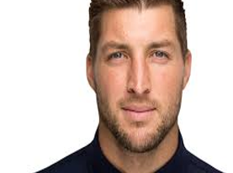
TIM TEBOW PROFESSIONAL FOOTBALL AND BASEBALL PLAYER
“It has to do with finding out how you learn. I’m not somebody that opens a playbook and just turns and reads and reads. So I just made flashcards. I take each one and then boom, when I’m traveling, I just flip through it. That really helped me. Writing it down, flipping through and quizzing myself, that was a great way for me to do it.”
Tim Tebow
Notes:
One of the foundational skills that will have an impact on a student's success in school, is their understanding of who they are as individuals and as learners. All transition plans should promote independence and self-advocacy

Slide 25
Transition Goal: Specific and achievable goals to support Transitions that are consistent with the student’s areas of strength and need.
Action
Responsibilities
Timeline
Steps needed to attain goals specific to the students transition
The roles and responsibilities of individuals carrying out the actions
Specific and realistic timelines in which actions can be accomplished

Slide 26
Sally – Grade 5
Transition Goal: Sally will advocate for her learning needs as she transitions to Grade 6.
Action
Responsibilities
Timeline
Facilitate understanding of Diagnosis, strengths, needs and recommendations as outlined in psychoeducational assessment
Create advocacy card/slideshow outlining strengths and needs
Share advocacy card/slideshow with new teacher
Resource teacher, parents
Student, resource teacher, classroom teacher
Student, resource teacher
Fall term
Winter term
June, September

Slide 27
Sally – Grade 8
Transition Goal: Sally will transition to develop skills to successfully transition to secondary school next fall.
Action
Responsibilities
Timeline
Continue to involve Sally in the creation and implementation of her IEP
Explore and begin to define interests, relating them to her skills and abilities
Select courses based on interests, skills and abilities
Review IEP and student profile with secondary school Resource Teacher
Attend open house and orientation session the secondary school
Resource teacher, classroom teacher, parents
Resource teacher, classroom teacher, Sally, parents
Sally, parents, resource teacher
Resource teacher, classroom teacher, Sally
Sally, parents
Ongoing
Fall
February
Spring
January, August

Slide 28
Sally – Grade 10
Transition Goal: Sally will attend a college or university program related to computer technology
Action
Responsibilities
Timeline
Investigate options and entrance criteria for computer technology programs at colleges and universities as part of (Individual Pathway Plan) IPP updates.
Ensure course selections include requisite courses for college/university admission. Add results to IPP.
Scheduled visits to college open houses and school career fairs including visits to Accessible Service Centre
Student, parents, guidance counsellor
Student, parents, guidance counsellor
Student, parents, guidance counsellor, resource teacher
Ongoing in grade 10
Ongoing
Grade 11 and 12

Slide 29
“WHERE POSSIBLE, STUDENTS SHOULD ASSUME RESPONSIBILITY FOR IDENTIFYING THEIR TRANSITIONS GOALS AND THE STEPS NEEDED TO ACHIEVE THEM”
P.E47 SPECIAL EDUCATION IN ONTARIO

Slide 31
Thank you!
Please complete the feedback form in your package before you leave.

