Slide 1
Individual Education Plans
Julie Savard and Lynn-Marie Pearce

Slide 2
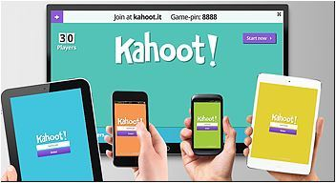
Test Your LD Knowledge
Go To
Kahoot.it
6 Quick Questions

Slide 3
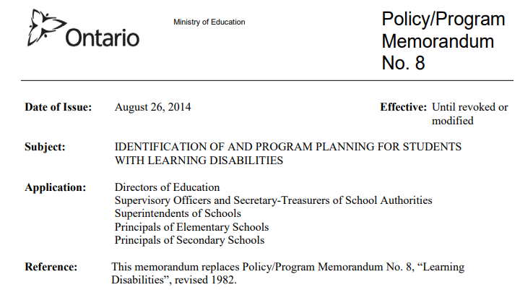
Ministry of Education Policy and Resources
Notes:
The supports and services that a school board provides are greatly influenced by the Policy and Program Memorandums and Resource documents that are provided by the Ministry of Education. PPM #8 which we will reference a bit later, and the Special Education in Ontario Kindergarten to grade 12 Policy and Resource Guide are used by all boards when looking at supporting students with a Learning Disability or ADHD. They help define the process and definitions that are used in education for students identified as having exceptional needs.

Slide 4
Learning Disability Exceptionality
p. A15-16 Special Education in Ontario Kindergarten to Grade 12
✧ affects the ability to perceive or process verbal or non-verbal information in an effective and accurate manner in students who have assessed intellectual abilities that are at least in the average range;
✧ results in (a) academic underachievement that is inconsistent with the intellectual abilities of the student (which are at least in the average range), and/or (b) academic achievement that can be maintained by the student only with extremely high levels of effort and/or with additional support;
✧ results in difficulties in the development and use of skills in one or more of the following areas: reading, writing, mathematics, and work habits and learning skills;

Slide 5
Learning Disability continued…
p. A15-16 Special Education in Ontario Kindergarten to Grade 12
✧ may typically be associated with difficulties in one or more cognitive processes, such as phonological processing; memory and attention; processing speed; perceptualmotor processing; visual-spatial processing; executive functions (e.g., self-regulation of behaviour and emotions, planning, organizing of thoughts and activities, prioritizing, decision making);
✧ may be associated with difficulties in social interaction (e.g., difficulty in understanding social norms or the point of view of others); with various other conditions or disorders, diagnosed or undiagnosed; or with other exceptionalities;
✧ is not the result of … lack of motivation or effort; gaps in school attendance or inadequate opportunity to benefit from instruction.

Slide 6
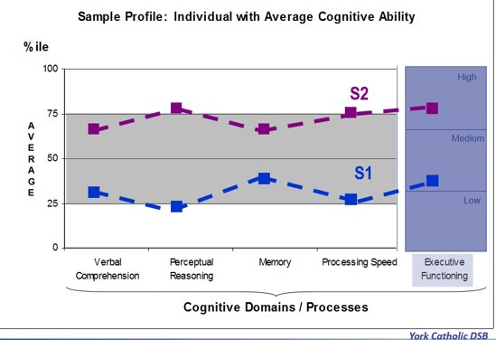
Cognitive Ability and Executive Functioning
Notes:
This graph is showing the profile of two students who are not identified and who have average cognitive abilities and executive functioning​
On this graph, the vertical axis shows the percentile rankings. On the horizontal axis, the four cognitive processes plus executive functioning are listed. ​
Verbal Comprehension is the ability to listen to and understand language​
Perceptual Reasoning includes nonverbal fluid reasoning, spatial processing and visual perception. Activities such as organizing and classifying objects, drawing inferences and problem solving use perceptual reasoning skills​
​

Slide 7
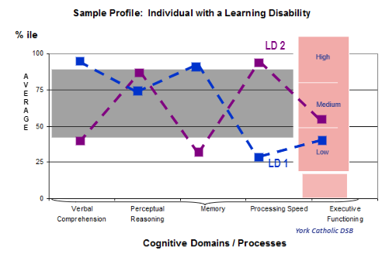
Knowing the learning Profile is Key
Notes:
Notice that there is a significant discrepancy between strengths and needs; needs are often in the below average range, yet strengths are in the average to above average range) and the differences in the strengths and needs between these two students means that presenting material and completing assessment the same for each person most likely would not give you an accurate measure of their performance. ​
Consider how executive functioning would affect each student in this example. How could it influence the student’s perception of his/her skills or teacher‘s perception of a student’s knowledge and skills that lead to assigning a grade?​

Slide 8
Learning Profile and Assessments
Norm Referenced Assessments
School-based Examples:​​
WIAT (LST/SPST)​
KT (LST/SPST)​
​
Specialized Examples:​
psycho-educational assessments​
speech-language assessments
​
​
Criterion Referenced Assessments
Classroom Based Examples:​​
conferencing​
observation​
analyzing work samples​
reading or math inventories​
DRA / Benchmarks​
PRIME​
DIBELS​
quiz
unit test
assignment (based on a rubric)
​
Notes:
A student’s Learning Profile is created based on results of Norm Referenced or Standardized testing by a Psychologist or Psycho-Educational Associate/Consultant.
Norm Referenced or Standardized Assessment
Done the same way each time, year after year ​
Content- items have been selected carefully by experts​
Administration- specific directions, procedures, time ​
Scoring- lots of rules, scoring tables, ​
Interpretation is standardized, using norms
It is important to understand an individual’s Learning Profile and how it will impact on his/her development and use of skills. The accommodations required to support difficulties with cognitive processes may vary from those needed to support executive functioning. But, providing accommodations increases the likelihood of achievement that is far more consistent with a student’s assessed intellectual ability. The Learning profile helps identify educational strengths and needs that will connect to appropriate accommodations for;
Learning new material,
Completing work in a classroom environment
Being assessed based on specific criteria
Criterion Referenced Assessment
In swimming lessons there is a list of skills that a person must demonstrate to earn a leveled badge​
Within a Swimming lesson group there may be differences in the performance of a skill i.e., specific skill may be easy or difficult for an individual but if the skills are all demonstrated to the instructor then each person in the group can earn the leveled badge​
In a classroom there may be an assignment that has a rubric or list of the criteria that needs to be met to complete the assignment​
Each person who completes the classroom assignment is evaluated using the rubric, but the rubric may have identified ranges of achievement that result in a different overall level (mark, grade) of 1-4 being assigned ​
Teachers plan lessons and units based on the Ministry of Education Curriculum that identifies skills and knowledge to be obtained as well as a way to communicate an individual's achievement of curriculum expectations​

Slide 9
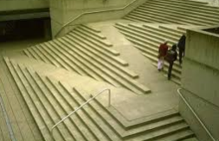
PPM #8 on Accommodations
“Instructional, environmental, and assessment accommodations should be provided, as appropriate, so that the student is able to access grade-level curriculum expectations and to demonstrate learning.​”
mental, and assessment accommodations should be provided, as appropriate, t is able to access grade-level curriculum expectations and to demonstrate learning.​
Getting
information
Into a student
Providing instruction and practice of skills
Getting
information
out of a student
Assessing Knowledge,
demonstrating skills
Notes:
Modification of learning expectations may include the use of expectations at a different grade level and/or an increase or decrease in the number and/or complexity of expectations. Modified learning expectations that are drawn from a lower grade level will only be considered if the student cannot demonstrate learning with the aid of any of the approaches and/or strategies described above.​
​

Slide 10
“Educational programming should focus on cognitive potential of the student with a Learning Disability and NOT their academic achievement”
Learning to Read
Reading to Learn
Accommodations
Support impacted areas and reduce barriers to promote reaching cognitive potential

Slide 11
Accommodations
Environmental accommodations: ​
Changes or supports in the physical environment of the classroom and/or the school ​
Instructional accommodations: ​
Adjustments in teaching strategies required to enable the student to learn and to progress through the curriculum ​
Assessment accommodations: ​
Adjustments in assessment activities and methods required to enable the student to demonstrate learning
​​
Preferred seating at the front of the class
Preferred seating away from the windows
Use of graphic organizers
Use of assistive technology (Text to speech/speech to text)
Use of math manipulatives
Extra time
Quiet space
Use of assistive technology
Notes:
Instructional accommodations: ​
When we think of the word accommodate we usually think of the the definition being to meet the needs of or to assist. We encourage you also consider the other meaning of accommodations which is when you provide shelter or accommodations, make room for... in other words you welcome and open your space to provide a place where someone can thrive. Accommodations are what a student needs rather than what they may want. Sometimes students actually don’t want to access the supports that are available. When that happens it is important for parents and the school to work together to encourage a student to not only have an understanding of what accommodations work best for them but to be able to self advocate when accommodations are not overtly offered.

Slide 12
Strengths, Needs and Accommodations
Teachers can leverage strengths when designing lessons, units and activities. Accommodations may reflect the strengths but are essential to address needs by supporting instruction and assessment of knowledge and skills.
Strengths
Visual Learner
Verbal Comprehension
Oral Expression
Memory
Works well in groups
Needs​
Reading – Decoding​
Written expression​
Math computation
Processing speed
Executive Functioning – focus, organization, task completion​
Notes:
Educational Strengths and Needs on an IEP come from a variety of sources:
Psych Reports, learning preferences, past performance, discussion with parents, observation of teachers, and sometimes from discussion with the student.

Slide 13
Operationalizing Strengths
Strengths
Visual Learner
Verbal Comprehension
Oral Expression
Works well in groups
Visual Learner​
Learns well when material is presented in picture or concrete forms​
Benefits from using graphic organizers to brainstorm ​
Visuals support comprehension of spoken and written material​
Remembers visual information better e.g., diagrams, charts, graphs, material they have written/typed​
May like flashcards for studying​
Oral expression​
May have an expanded vocabulary​
May be successful when expressing thoughts and feelings, describing or explaining experiences of concepts​
May need to talk through concepts, ask questions to clarify understanding​
May benefit from opportunities for group discussion​
May like to study using Mnemonics, or by reading information out loud​
May be able to provide verbal answers with increased details and complexity vs written answers
Notes:
Understanding a student’s learning profile includes operationalizing or defining educational strengths so that they can be leveraged during both instructional and assessment opportunities. Two students could have the same strength listed but have it impact learning differently e.g., some students may need a fixed graphic organizer where others may not be linear thinkers and need a flexible way to organize thoughts. The more we understand strengths and needs, the better able we are to match those strengths and needs with the accommodation that is the right fit.

Slide 14
Accommodating
Needs
Instructional Accommodations​
Use of assistive technology (text to speech and speech to text)​
Duplicate or electronic notes​
Graphic organizers and mind maps​ (electronic preferred)
Organizational coaching and time management aids​
Visual and verbal cueing ​
Extra time for processing​
Use of manipulatives
Chunk work into sections
Environmental Accommodations​
Strategic seating near the teacher’s desk, beside a calm peer
Quiet setting​, or use of an alternate work space
Use of headphones or study carol when needed​

Slide 15
Accommodating
Needs
Assessment Accommodations​
Oral responses, including recorded responses (audio or video)​
Oral explanations of written answers​
Use of assistive technology (text to speech and speech to text)​
Access to learning tools (manipulatives, number chart)​
Prompts to return student’s attention to task​
Extended time limits​
Reduction in the number of tasks used to assess a concept or skill​
Environmental Accommodations​
Strategic seating near the teacher’s desk, beside a calm peer​
Quiet setting​, or use of an alternate work space
Use of headphones or study carol when needed​

Slide 16
Continuum of Support
Least to Most Intrusive Pathway of Support
1st
2nd
3rd
4th
5th
6th
Universal Design
Remediation
Intervention
Accommodated Only Programming
Modification at Grade level
Modification to a different Grade
In-Class planning for success of all students
Differentiated Instruction and assessment
In-Class review, re-teaching and extra practice to develop skills or knowledge
Targeted intervention by the classroom teacher
In-Class intervention including direct instruction and increased intensity of remediation strategies
Use of evidence based interventions
May be in an informal plan arranged at a Team Meeting
School Team may recommend creation of an IEP
May involve support from Special Education Teacher
Supported by IEP
Program Modification based on grade level is required
Accommodations in place to support
Progress is monitored by a team
Accommodations continue to be in place.
Program Modifications at grade level are not resulting in successful achievement
Modification to grade level to develop specific skills is required

Slide 17
Remediation Compensatory Strategies
Guided practice
Small group
Direct Instruction
Guided Reading
Guided Mathematics
Tiered intervention
Assistive Technology (text to voice, voice to text, word prediction)
Practice and review
Organizational strategies
Note taking strategies
Study skills
Metacognitive strategies-- thinking about your own thinking
Notes:
Remediation-seeks to fill the gaps using a variety of programming strategies that will effectively “bring the students’ achievement in line with their cognitive abilities.
Compensatory strategies- while we don’t want to throw the baby out with the bath water we need to recognize that as the student with a LD gets older and moves into the intermediate grades and onto secondary school these become essential as they learn strategies to compensate for the deficit.

Slide 18
UDL to Support Students with a Learning Disability
Compensatory Aids for All | Assistive Technology Checklist Visual Timers Consistent Routines
Choice | Focus on passions Focus on strengths and talents Consider preferred learning style
Tiered Intervention | Guided interventions as needed Students are not left to struggle
Notes:
Universal Design for Learning is an Educational Framework that guides the development of flexible learning environments that can accommodate individual learning differences including students with a learning disability
Compensatory aids for all, choice for all and using a tiered intervention approach are all components of UDL.

Slide 19
Consideration for Guided Groups/Tiered Intervention
3-4 times per week
2-3 times per week
Once per week
Identified students
Students at risk
Students with specific Intervention goals or targets
On target learners
Advanced learners
Notes:
This is but one strategy used to held educators provide for remediation within the context of a Universally Designed Classroom.

Slide 20
PPM #8 on Modifications
Modification of learning expectations may include the use of expectations at a different grade level and/or an increase or decrease in the number and/or complexity of expectations.
Modified learning expectations that are drawn from a lower grade level will only be considered if the student cannot demonstrate learning with the aid of accommodations, differentiated instruction or universal design for learning
Notes:
We can not reiterate the importance of the ministry policy regarding modifications for students with LD. Think if it as a last resort. Always taking into consideration the learning profile of the child.

Slide 21
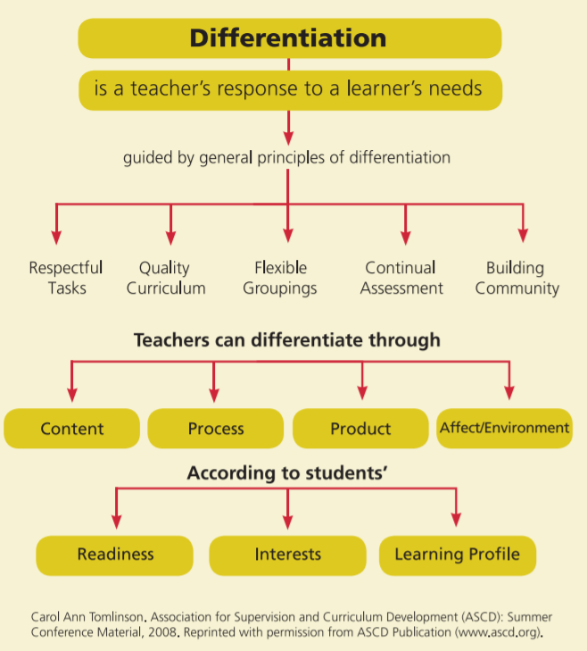
This is necessary for all learners including a student with LD.
Notes:
Here we can gain a better understanding as to why a Learning Profile is so important for instruction. It supports in the differentiated response to the student’s learning needs. Respectful of student base of knowledge, cultural and linguistic background.

Slide 22
Notes:
What big ideas are important− the degree of structure or open-endedness of the task − the pace of learning − the degree of independence − the presentation formats − the reading level of materials − the products and assignments to demonstrate learning.

Slide 23
With Differentiated Instruction,teachers can differentiate:
content of learning-Input (what students are going to learn, and when)
process of learning-Process (types of tasks and activities)
products of learning-Output (ways to demonstrate learning)
affect/ environment of learning
Notes:
Content-What and When consider focusing on big ideas and student readiness
Process-What types of tasks are you going to have the student completing
Products-How are they demonstrating their learning
And of course the environment

Slide 24
Alternative Programming
What it is…
Alternative curriculum
Determined by the student learning profile (Strengths/Needs)
Developed to help the student acquire other skills
Driven by data and assessment
Can be connected to the Learning Skills and Work Habits section of the Report Card
What it’s not…
Not based on Ontario curriculum
Not an exhaustive list of all things the student needs to learn, rather the focus for a period of time
Notes:
Often focused on areas of need related to executive functions (planning, organizing and initiating tasks), learning skills, assistive technology

Slide 25
Alternative Programming
Must have the current level of achievement, an annual program goal, learning expectations, teaching strategies and assessment methods
Notes:
Alternative programming is similar to academic program areas because they require all of key components. Teaching strategies and assessment methods will directly relate the specific expectations being worked on

Slide 26
An Example: Assistive Technology
To support student learning around specialized technology use
Should include students with SEA laptop/chromebook, as well as, FM systems
Should include use of technology across all areas of the curriculum
May include targets for specific skill development ( e.g., use of spell check, use of word prediction, speech to text, text to speech)
May include student self-advocacy around use of technology

Slide 27
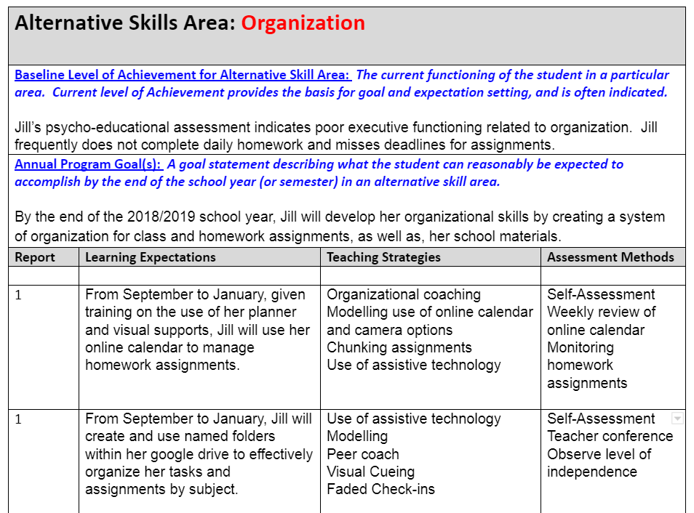
Example: Alternative Program: Organization

Slide 28
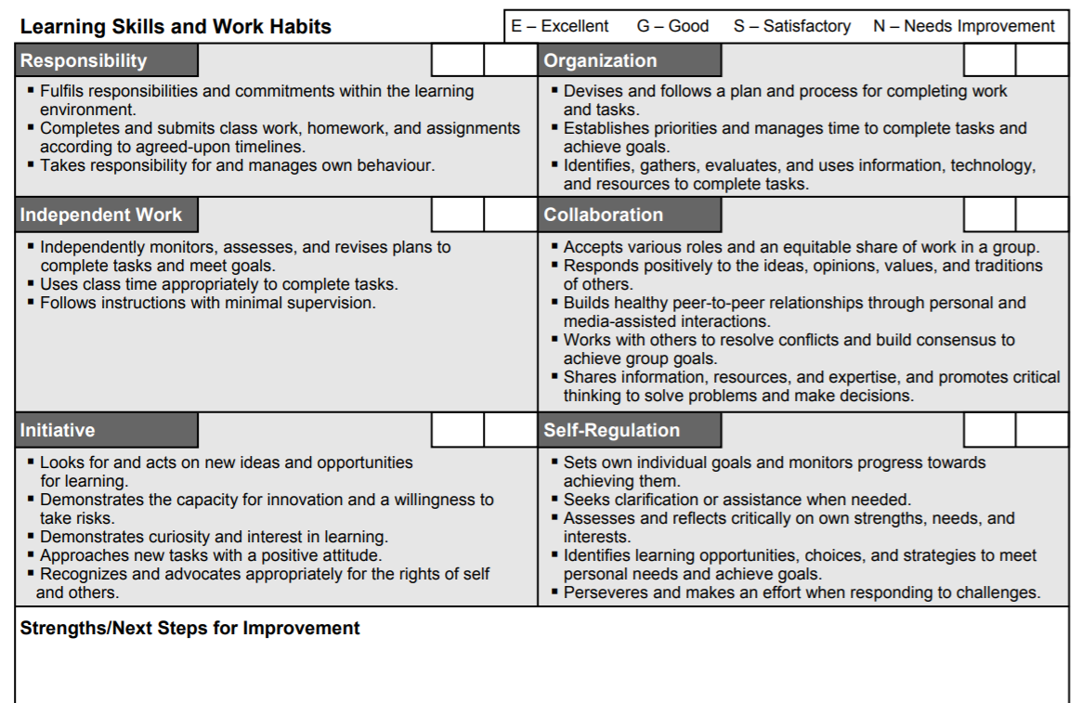
Sample Report Card
Ties to alternative program
Achievement towards alternative programs may be indicated within the LS/WH comments
Notes:
How do we connect Alternative programming to the Learning Skills and Work Habits on the Provincial Report Card?

Slide 29
Transition Planning
Ministry of Education Policy Program Memorandum 156:
“For students who have an IEP, the transition plan must be reviewed as part of the review of the IEP. The results of each review should be used to update the transition plan.” The transition plan must be updated at least once a year.
Notes:
PPM 156 SUPPORTING TRANSITIONS FOR STUDENTS WITH SPECIAL EDUCATION NEEDS was issued in 2013 requiring school boards to develop transition plans for all students from k-12 to support students throughout their educational program.
For students with LD the transition plan must be reviewed as part of the review of the IEP. The results of each review should be used to update the transition plan.

Slide 30
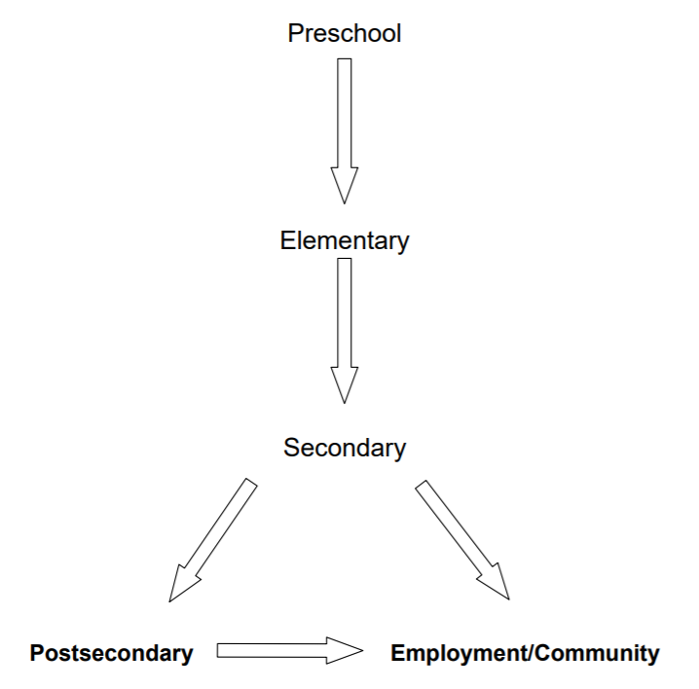
Notes:
Transition planning is completed throughout the educational timeline for student identified with a Learning Disability. Careful consideration at each step is needed to ensure success for the student at the next step in the flowchart.

Slide 31
Students with LD Centered Transition Planning
Learning Profile
Promotes independence and Self-Advocacy
Actionable Steps
Roles & Responsibilities
Timelines
Necessary Changes in the Service System
Notes:
Teams must take into consideration a number of items when transition planning for a student with LD.

Slide 32
Steps to Transition Planning
Gather the Team | Assess and Identify | Develop Transition Goals | Create the Plan | Monitor Progress
The teacher usually needs to set the team, initially. Invite any professionals involved, caregivers and the student. Keeps and distributes minutes. | Work with the student to think of ways to actively involve the student in assessment. Help the student and the team to identify goals. | Focus on what will enhance the student’s life most and move them towards graduation. Use SMART goals: Specific Measurable Attainable Realistic Time Based | List the steps for goals set for each of the three areas on the transition plan. Do a task analysis or rating scale if necessary to identify needed skills. | Use data to see if goals are met (if specific) or review the goal at the next meeting. Is there progress? If not, new strategies will be needed.
Notes:
Assess and Identify-Can support transition planning around self-advocacy (incorporation of student voice), When we consider the team.
Team members can also include agency supports (LDAO, parent advocate and depending on the age of the student they would also be included.
In Secondary, it would likely be the Head of Special Education responsible to gather the team and ensure all required staff be involved in the process.

Slide 33
Post Secondary & Beyond
Points to Consider
Notes:
Secondary to post-secondary and beyond
Given the diversity of students with learning disabilities, a wide range of appropriate education and employment options should be considered.
Assist students in the careful selection of senior high school courses. Consider students’ abilities and their level of performance with accommodations to ensure that students are in the appropriate courses. Consider the reading and writing demands of courses, and balance the load each term

Slide 34
Resources
Learning For All (2013)- Ministry of Education
Special Education in Ontario schools (2017)- Ministry of Education
Collaborating for Better Individual Education Plans -Ministry of Education
Shared Solutions - A Guide to Preventing and Resolving Conflicts Regarding Programs and Services for Students with Special Education Needs- Ministry of Education. 2007
Transition Planning for the IEP (2014)

Slide 35
We Welcome Your Feedback
Please type in the link in your address bar
https://forms.gle/zeuVsEno54tjpebH8

Slide 36
Thanks!
Any questions?
You can find us at:
Julie Savard
@JES4V4RD or Email j.savard@tvdsb.ca
Lynn-Marie Pearce
Email lpearce@ldcsb.ca

