Slide 1

Welcome to SSD at Western!
Services for Students with Disabilities (SSD)

Slide 2
Students Seeking Support through SSD for any Type of Disability

Slide 3
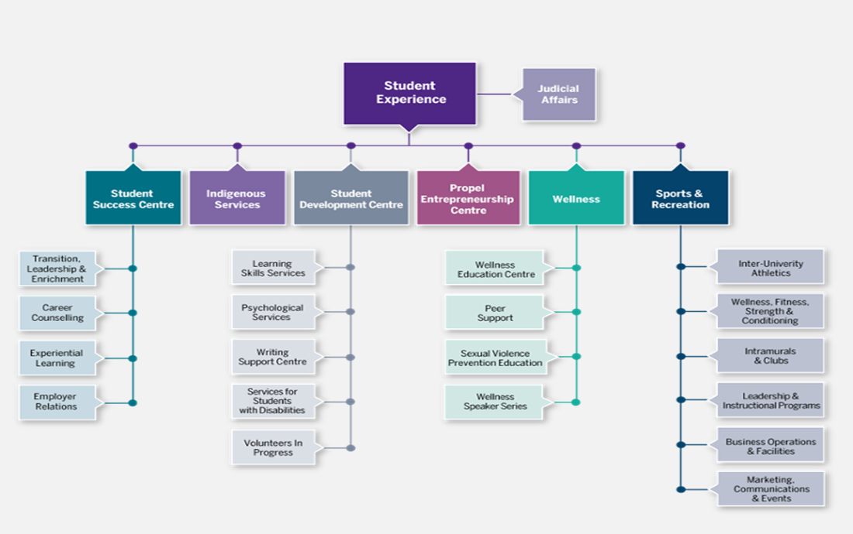
SSD - Who are we?

Slide 4
An accommodation is not….
… an unfair advantage.
… necessarily taken from a student’s high school IEP.
… every recommendation from a psychologist’s report.

Slide 5
Examples of Accommodations
:
access to alternative format textbooks (e.g., electronic, Braille)
access to accessible versions of powerpoint slides and other documents on course websites
use of sign-language interpreters in class
use of an FM system in class
permission to tape record lectures
writing exams in a quiet location
use of extra time when writing exams
use of assistive technology when writing exams (e.g., a computer equipped with specialized software)

Slide 6
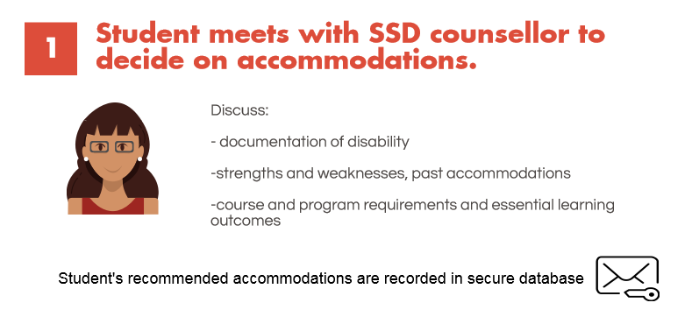
Arranging Accommodations

Slide 7
What documentation is needed?
Must come from a professional who is qualified to diagnose the condition and to comment on associated difficulties that may arise at university
Can be
  A completed documentation form
  A report from diagnosing professional (LD, ADHD)
  An IEP may be sufficient for a student’s first year
Documentation is kept in a students file at SSD and not shared with any other part of the university

Slide 8
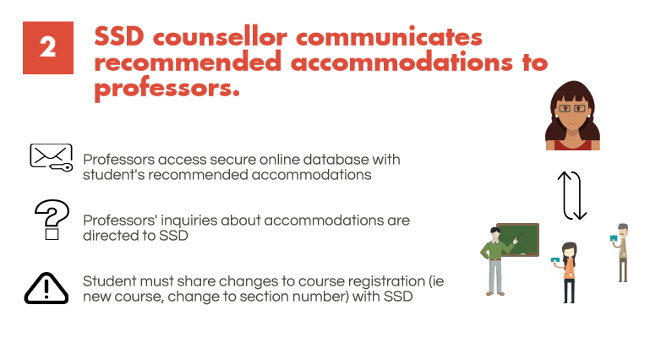
Arranging Accommodations

Slide 9
What about self-advocacy?
Don’t I have to discuss my disability with my professors?
Information about your disability is private
It is your choice who you share this information with
Documentation required to register with SSD is kept in a confidential file – not available to anyone else at Western
Only information about your recommended accommodations is shared with professors/other relevant university staff
If you have questions about sharing your disability information, discuss with your SSD counsellor

Slide 10
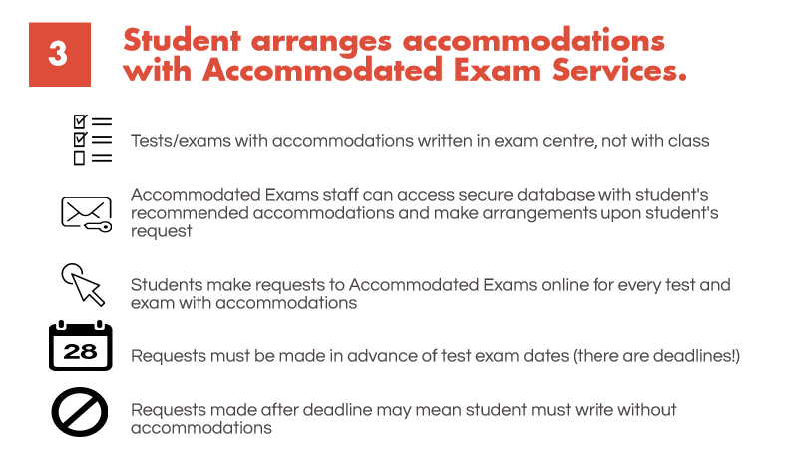
Arranging Accommodations

Slide 11
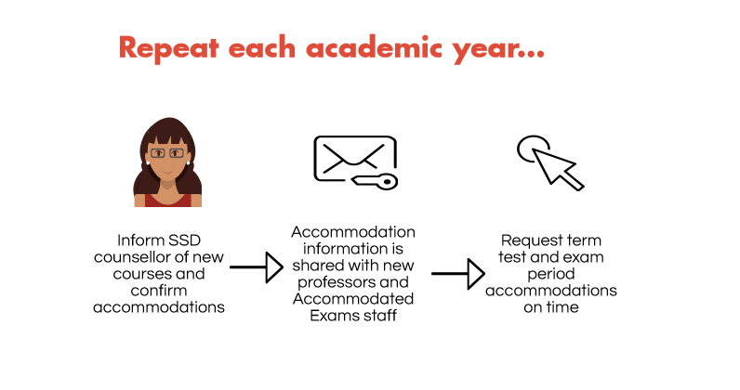

Slide 12
Successful students who use SSD…
Contact their SSD counsellor as soon as they have registered in new courses each year
Make requests for test accommodations from Accommodated Exam Services on time
Consider reducing their courseload in order to better manage their studies
Are aware of how well they are doing in each course and ask for help early

Slide 13
Other supports SSD provides….
Assistive technology consultation and training
Print materials in alternative formats
Learning strategy instruction
Accessible campus transportation
Interpreter/Note-taking service for students who are deaf or hard of hearing
Access to study spaces on campus (distraction-reduced, technology-equipped)

Slide 14


Learning Skills Services
http://www.sdc.uwo.ca/learning
The goal of Western's Learning Skills Services is to make good students even better students. The counsellors answer questions and provide advice on how to be successful at Western. They help students develop new skills or strengthen existing academic skills. Students can choose from a variety of services:
make an individual appointment with a learning skills counsellor,
attend learning skills presentations,
drop by SDC's Learning Help Centre,
or receive helpful information via e-mail
information on important learning skills topics is available online
Learning Skills Services is open to all Western students!
Notes:
Title Page

Slide 15

The Leadership and Mentorship Program (LAMP 1.0) connects new students with a Peer Mentor from their Faculty or Program
LAMP 1.0 mentors are high caliber student leaders representing all faculties who are carefully selected and extensively trained. For all LAMP Leaders, the first-year experience is still a fresh memory, and they are sensitive to the challenges faced by first-year students
LAMP Mentors are committed to:
Ensuring that all first year students are welcomed to Western in a positive and healthy manner.
Meeting the needs of first-year by maintaining regular contact with fist-year students via phone and email.
Providing information about resources both on and off-campus.
Providing a support network for first-year students through academic, social and personal development.
http://www.success.uwo.ca/new_students/leadership__mentorship_program/index.html
Notes:
Title Page

Slide 16
TUTORING AT WESTERN
  Generally offered by graduate students or upper year undergraduate students by private arrangement
  Tutors will advertise their areas of expertise and availability online at Western’s tutor registry website.
  The website is maintained by staff volunteers and is provided as a service only. It can only be accessed by Western students. Tutors are not screened or trained, so students are encouraged to use caution when contacting and meeting tutors.
  Tutors will also advertise on Kijiji. Be extremely cautious if you use Kijiji to locate a tutor because anyone can post there.
  Your professor may be able to suggest someone who can tutor their course content.
Notes:
Title Page

Slide 17

Psychological Services
http://www.sdc.uwo.ca/psych
Psychological Services offers individual counselling and group workshops for a wide range of concerns faced by students such as:
  Relationship Issues Decision-making Issues Sexuality Loneliness
  Adjustment Issues Social Anxiety Stress Depression/Anxiety
  Self Esteem Issues Abuse Issues and more….
The following are some of the group workshops that have been offered by Psychological Services:
  Emotion Regulation Group Distress Tolerance Group Social Anxiety Group
  Managing Anxiety and Stress Group Mindfulness Meditation Group
  Public Speaking Anxiety Group Healthy Relationships and Effective Communication Group
Notes:
Title Page

